Slide 1
AIR PAINTING
Guided By:
Ms.Riddhi Patel

Slide 2




Our Team
Manoj Bari
19BEIT30040
Vashishth Patel
19BEIT30067
Jaydip Patel
Happy Parmar
19BEIT30029
19BEIT30019
Notes:
Source of Image:-
https://www.freepik.com/free-photo/portrait-of-young-businessman-talking-on-mobile-phone-near-the-window_3156903.htm#term=corporate%20people&page=2&position=12
https://www.freepik.com/free-photo/smiling-business-woman-pointing-finger-on-copy-space-isolated-portrait_1119372.htm#term=corporate%20people&page=5&position=19
https://www.freepik.com/free-photo/smiling-mature-businessman-talking-on-mobile-phone_3105768.htm#term=corporate%20people&page=6&position=27
https://www.freepik.com/free-photo/smiling-brunette-manager-with-crossed-arms_899841.htm#term=corporate%20people&page=8&position=36

Slide 3
Agenda
1
ABSTRACT
2
INTRODUCTION
3
What is Air Painting ?
4
TECHNOLOGY
5
ALOGORITHM
6
SYSTEM METHODOLOGY
7
SCREENSHOT

Slide 4
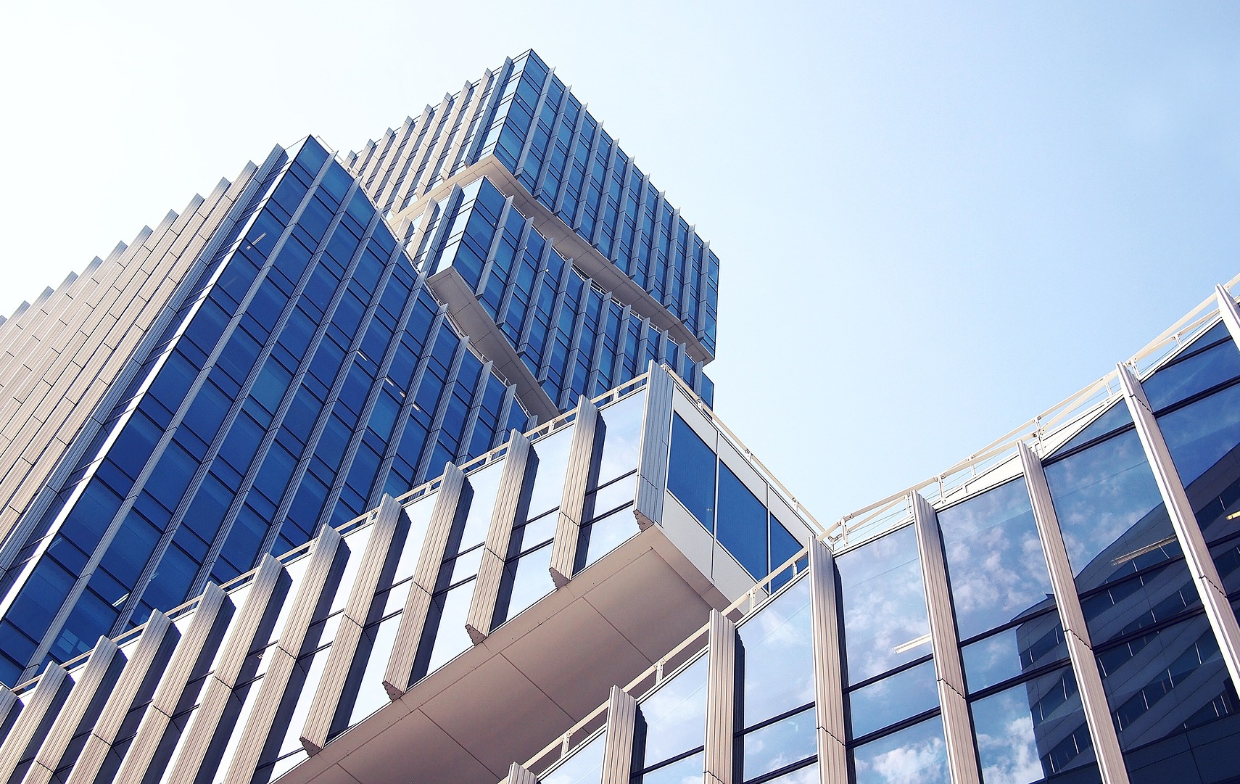
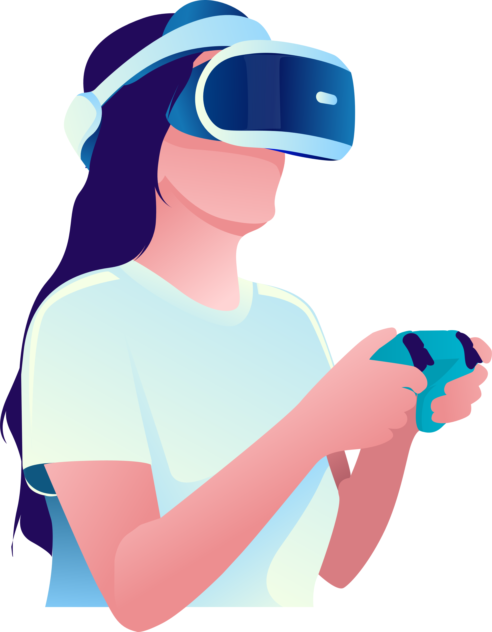
Abstract
Writing in air has been one of the most fascinating and challenging research areas in field of image processing and pattern recognition in the recent years
Object tracking is considered as an important task within the field of Computer Vision.
we will do hands-on implementation on how to create a virtual painting app without touching the keyboard, and just by drawing on-air that will be displayed on the screen
There are various methds for processing and manipulation of data to get the required output.
Notes:
https://pixabay.com/photos/architecture-building-amsterdam-1448221/

Slide 5
Introduction
We know that artists create paintings on a canvas. But what if we can paint on air just by waving our hands. So, in this project, we are going to build an air canvas using OpenCV and Python.
This is build an OpenCV application that can track an Air paint colour , using which a user can draw on the screen by moving the hand around draw virtual paint the color.
We’ll use color detection and segmentation techniques to achieve this objective.
Here, we’re going to use a BLUE object to simulate a pencil for the canvas.

Slide 6
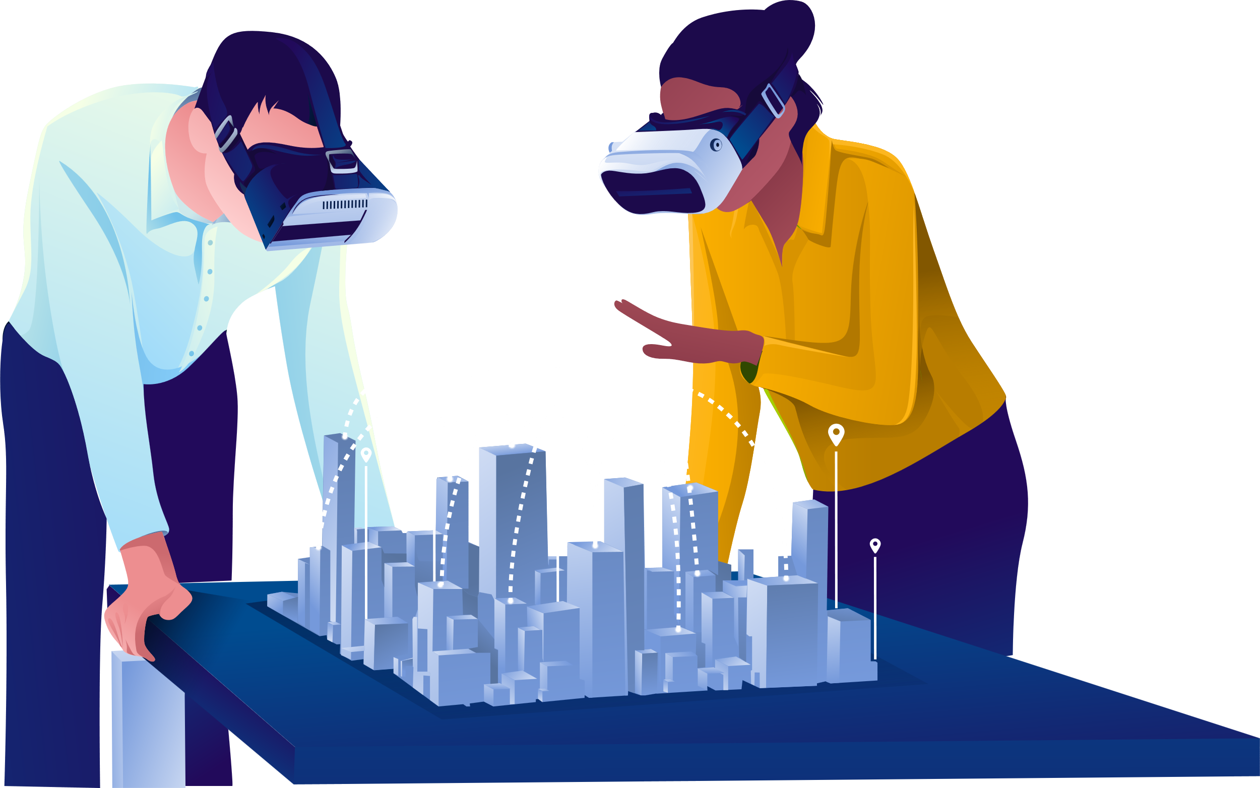
What is Air Painting?
Air Canvas is a hands-free digital drawing canvas that utilizes OpenCV to recognize and map hand gestures onto a screen.
The user’s “brush” can be modified in size and color by using built-in buttons.
The direction of the brush is controlled completely using open source OpenCV software .
The idea for Air Canvas was a result of our interest in digital drawing and smart photo recognition software.

Slide 7
Technology
Technology:
Python
Tools:
Library:
Numpy
OpenCV
VS Code
2
3
1

Slide 8
Alogorithm
Start reading the frames and convert the captured frames to HSV color space (Easy for color detection).
Prepare the canvas frame and put the respective ink buttons on it.
Adjust the track bar values for finding the mask of the colored marker.
Preprocess the mask with morphological operations (Eroding and dilation.
Detect the contours, find the center coordinates of largest contour and keep storing them in the array for successive frames (Arrays for drawing points on canvas).
Finally draw the points stored in an array on the frames and canvas.

Slide 9
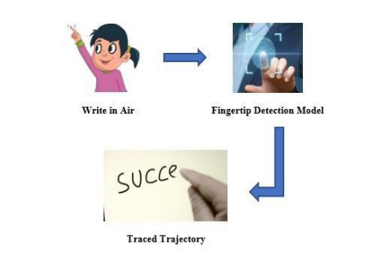
System Methodology
This system needs a dataset for the Fingertip Detection Model. The Fingertip Model's primary purpose is used to record the motion, i.e., the air character.
Notes:
https://pixabay.com/photos/room-flower-white-cabinet-plant-4161931/

Slide 10
SCREENSHOTS

Slide 11
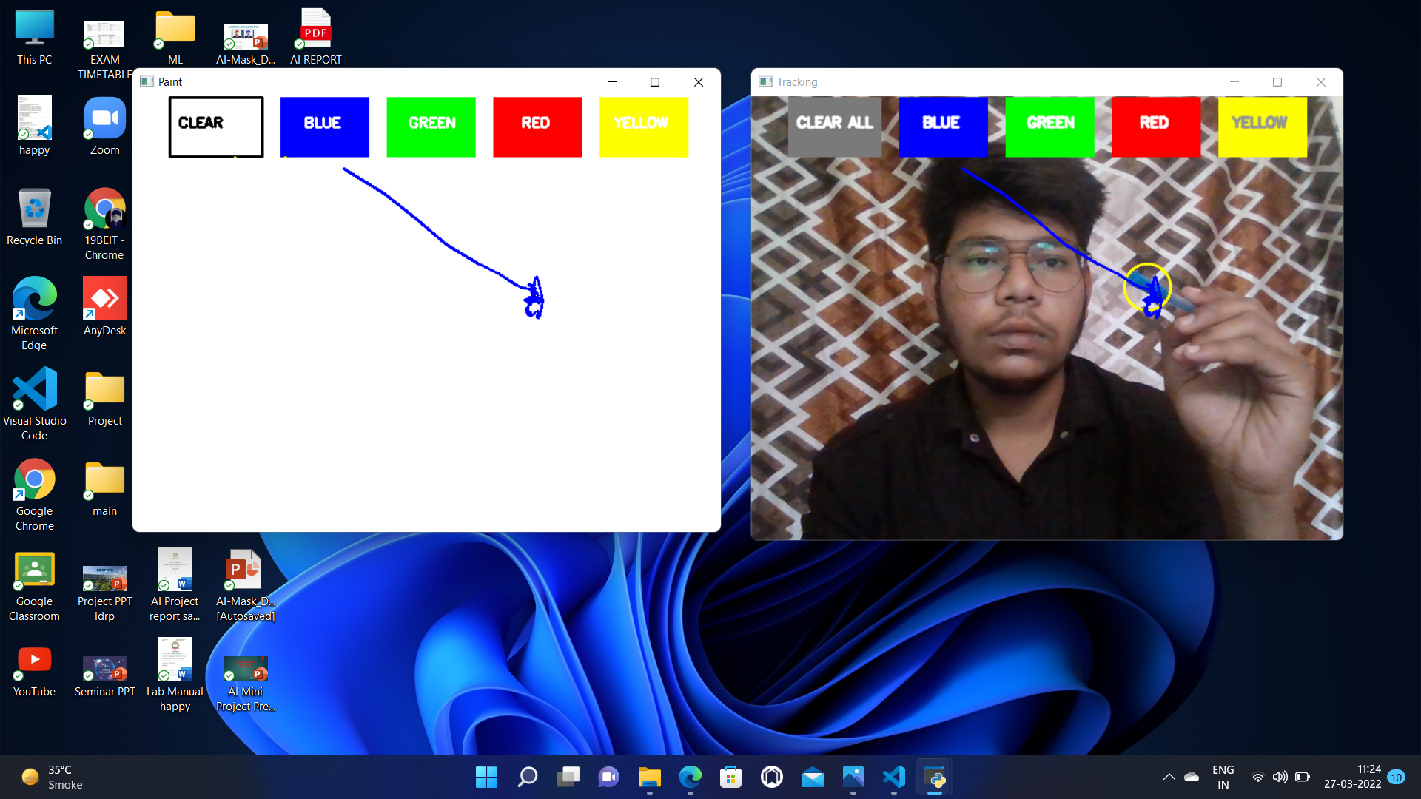


Slide 12
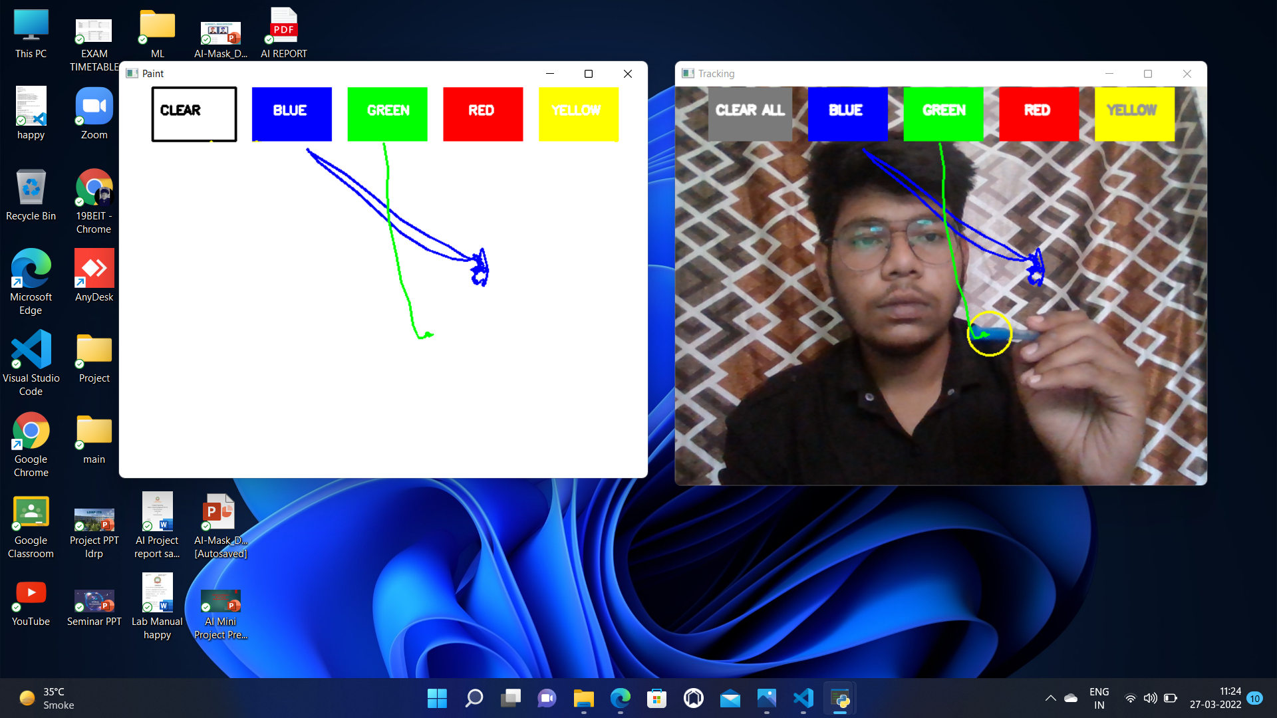

Slide 13
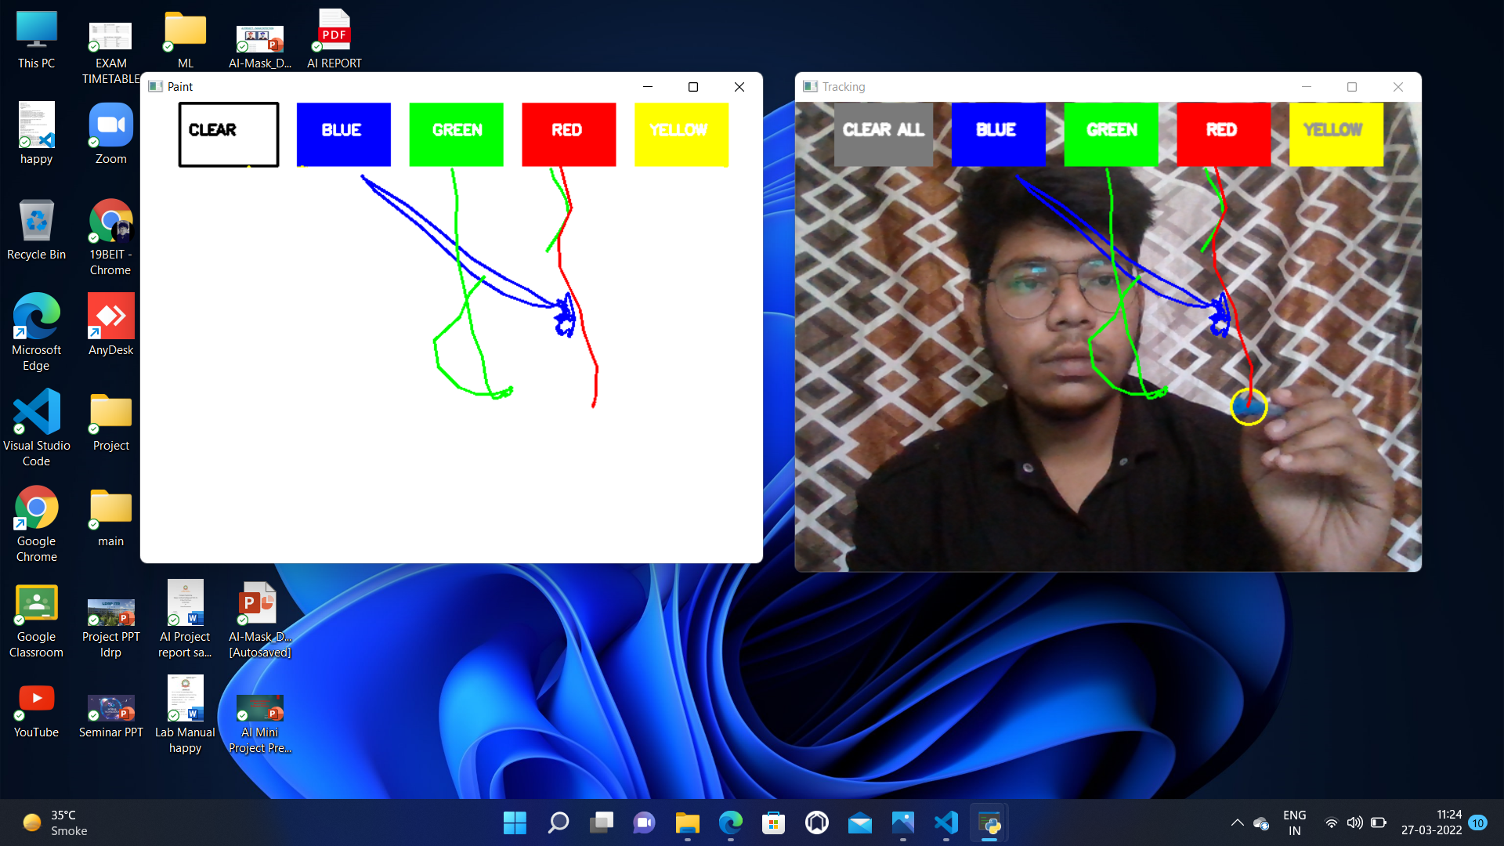

Slide 14
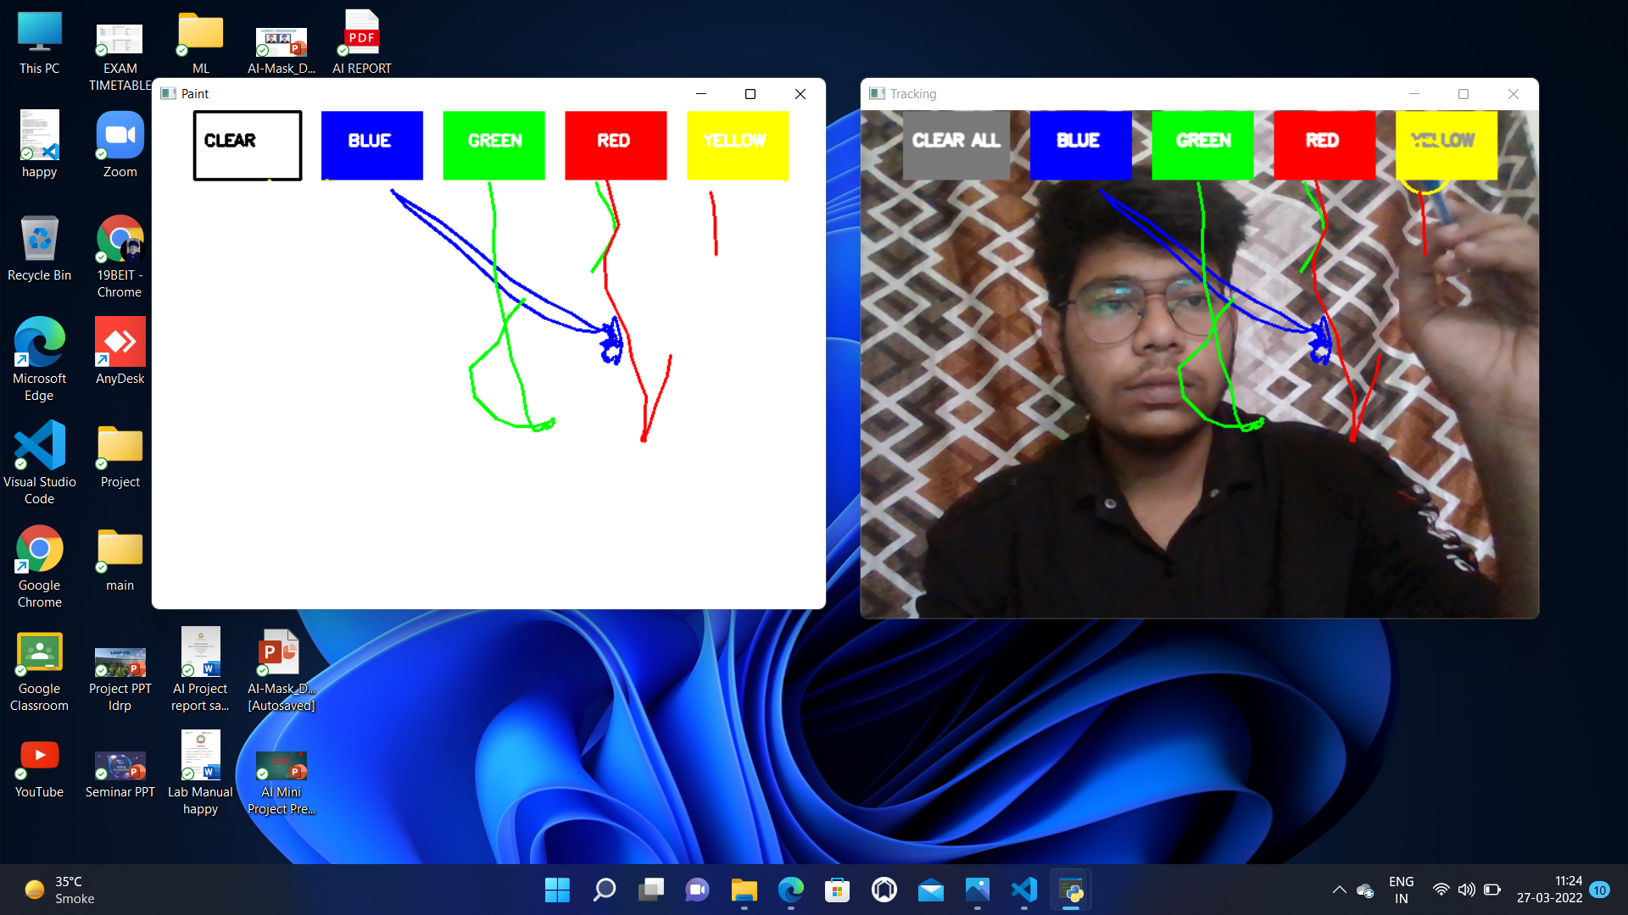

Slide 15
Thank You

